Slide 1

Real-Time Gesture Recognition for Presentations

Slide 2
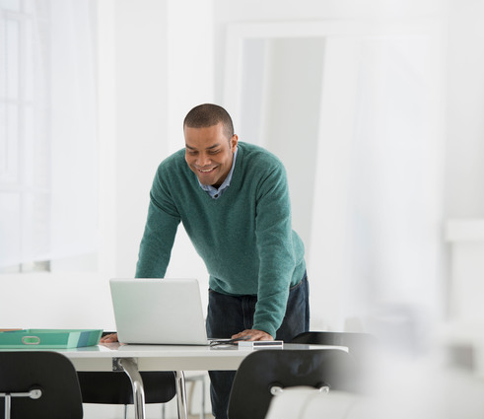
Problem Statement
Traditional methods of controlling presentations, such as using a remote or keyboard, can be limiting and less interactive.
Our project aims to address this challenge by developing a Gesture-Controlled Presentation system that allows presenters to seamlessly control their presentations using hand gestures and motion tracking.

Slide 3
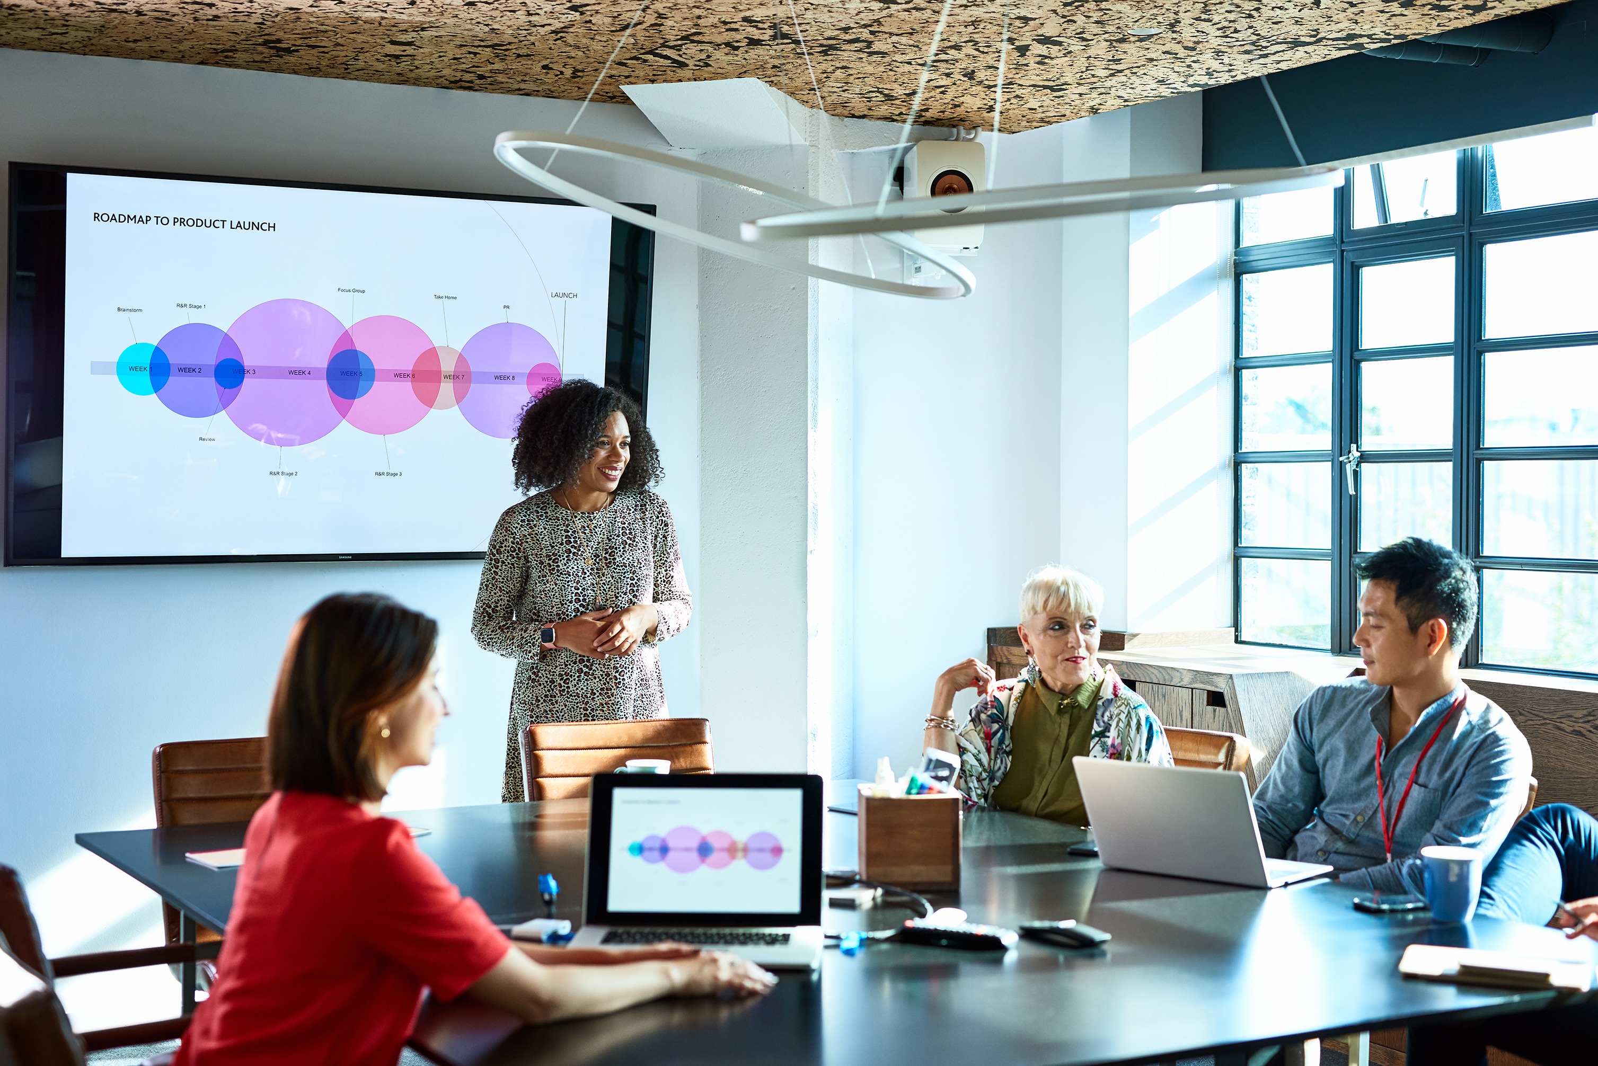
The Problem Domain
The Problem Domain include:
Image Processing
Gesture Classification
Presentation Control

Slide 4
Relevant Literature Support
A Hand Gesture Based Interactive Presentation System Utilizing Heterogeneous Cameras
Hand Gesture Recognition in Real Time for Automotive Interfaces
Vision-based hand pose estimation: A review
Visual interpretation of hand gestures for human-computer interaction: a review
Gesture Recognition: A Survey

Slide 5
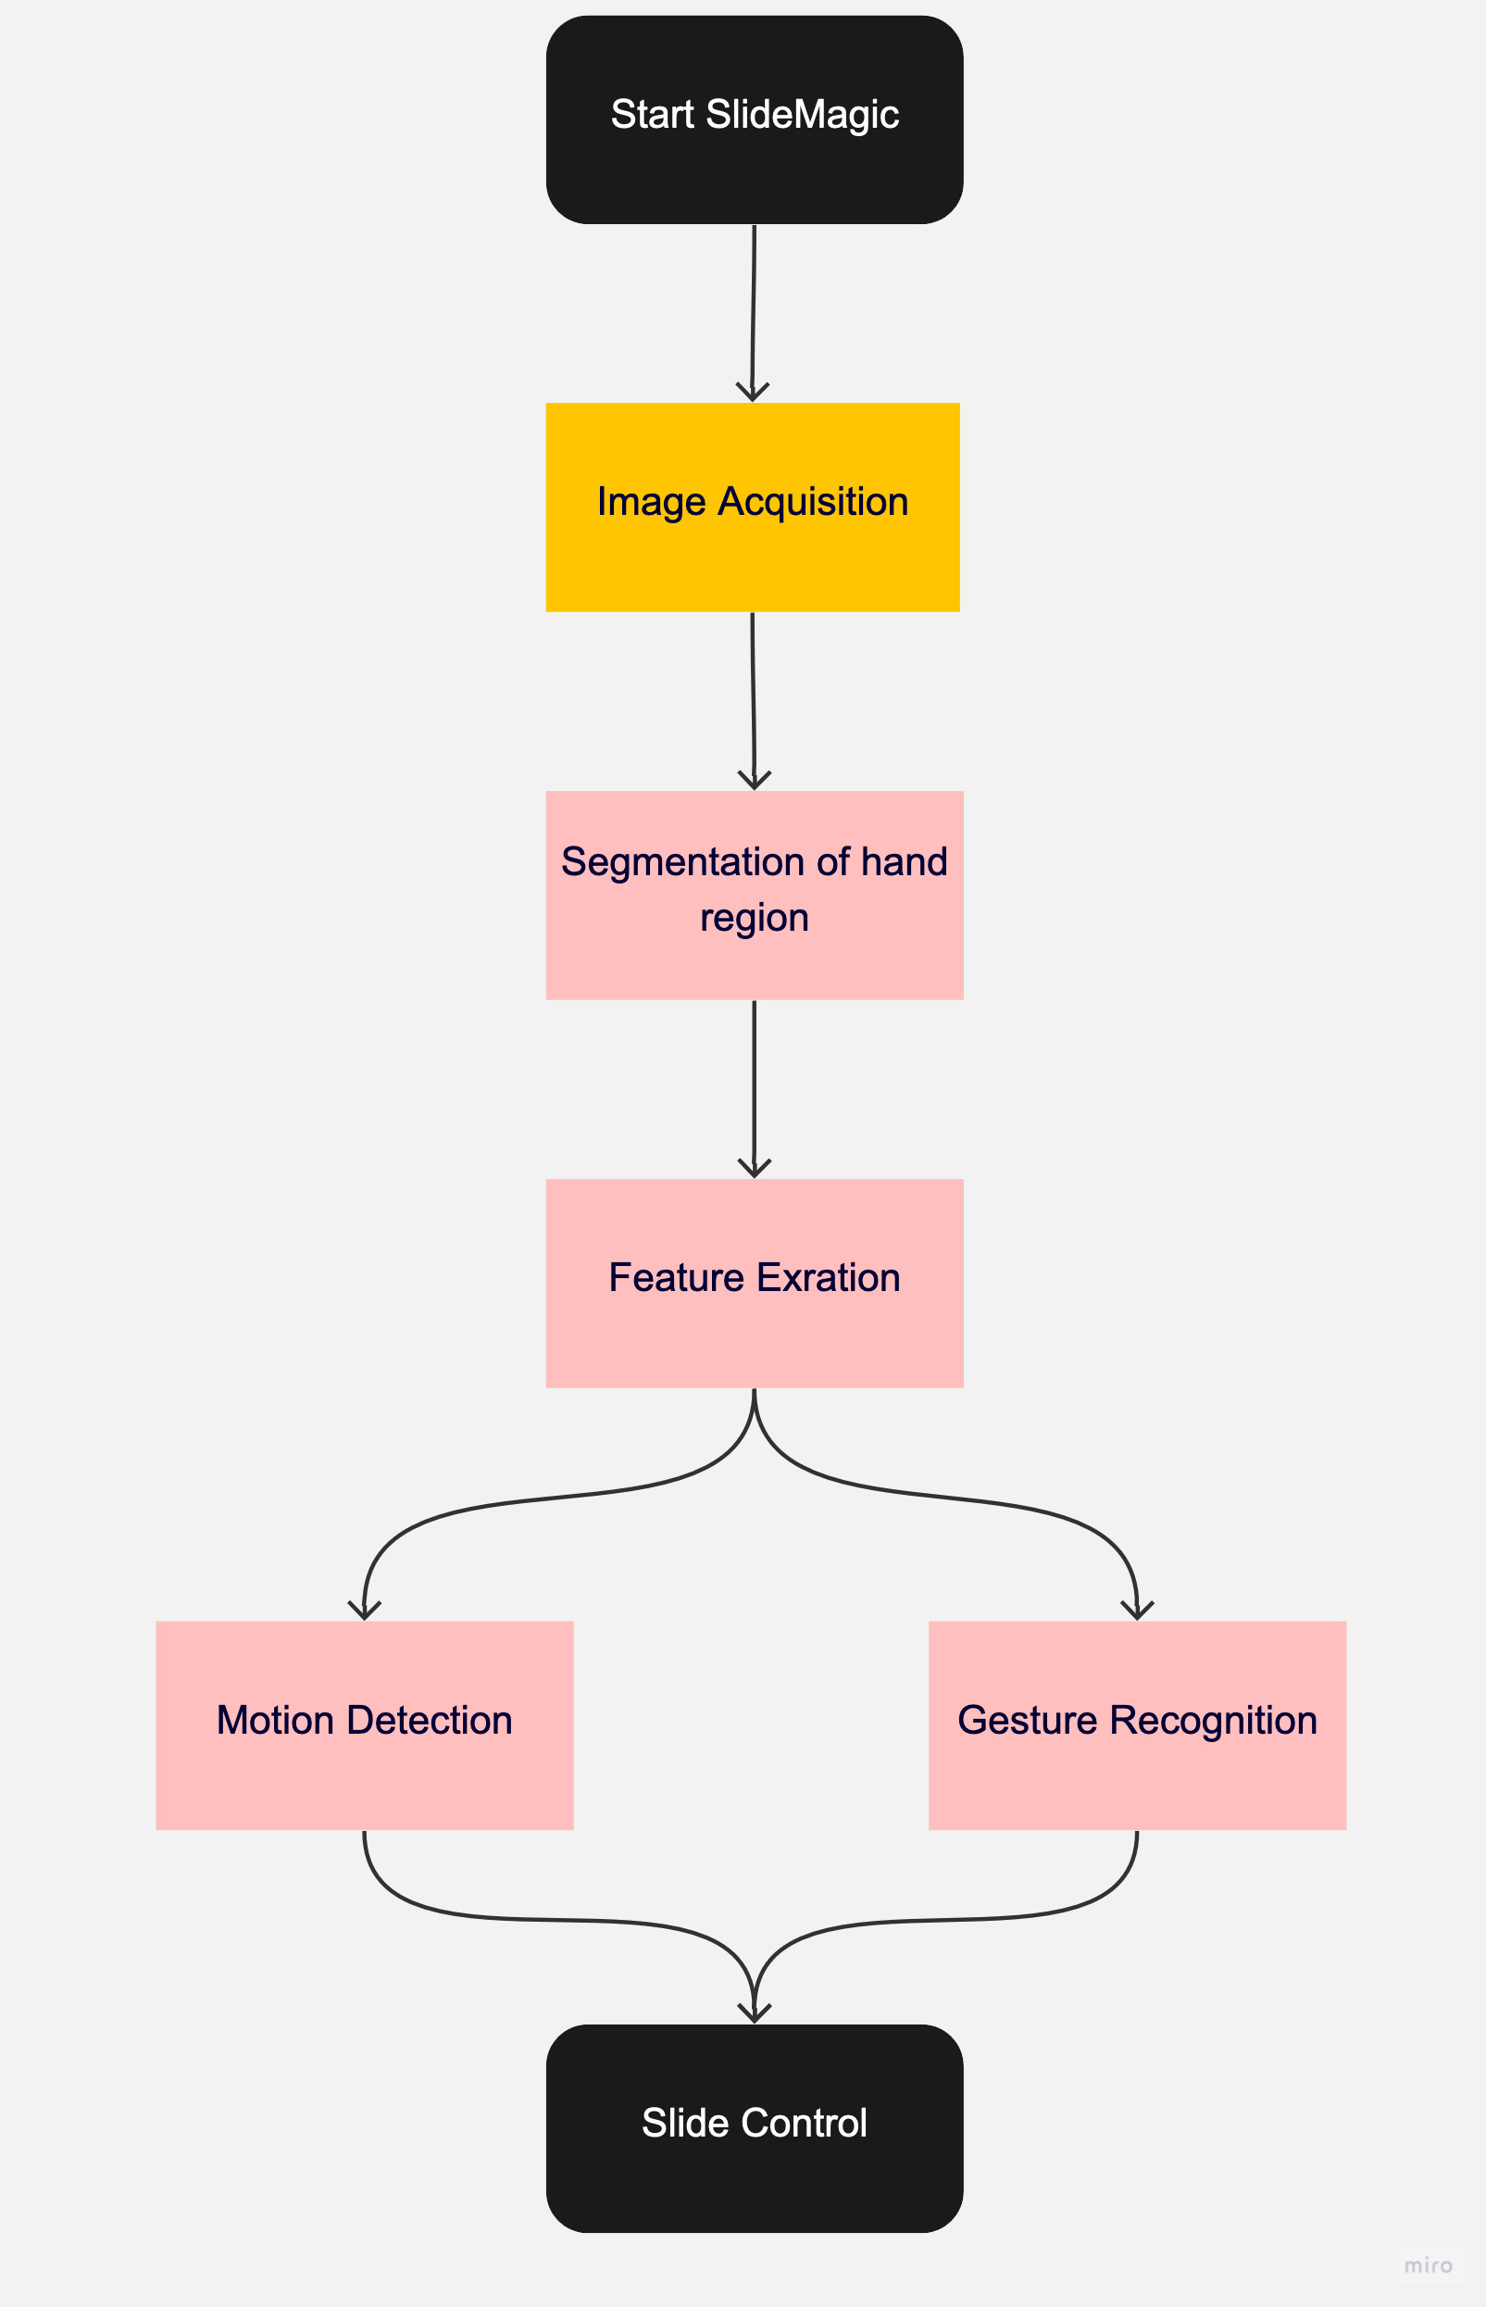
Proposed Solution
The proposed solution for gesture-based presentation control involves the use of camera that can detect hand gestures and translate them into commands for the presentation software.
The workflow diagram illustrates how this solution will work in practice. The presenter will use various hand gestures to navigate through the presentation, such as swiping left or right to move between slides, pointing to highlight specific content. The algorithm will detect these gestures and send the corresponding commands to the presentation software, which will then execute the desired action.

Slide 6
Module Split Up
To address the problem of gesture-based presentation control, we propose a modular approach that consists of three main modules:
Hand Segmentation
Motion Detection
Gesture Recognition
Presentation Control

Slide 7
Implementation Details
The implementation will be done as a python script. And the user will be able start the program using a simple command.
The modules that will be used for development are:
cvzone
mediapipe
Opencv
These Packages use CNN at low level to process images.
To detect hand movement, we use Finite State Machine.

